Slide 1
For Live Session
Unit 12
Carlos Estevez

Slide 2
Activity One: Check Out These GitHub Pages (30 min)
https://yelp.github.io/
square.github.io
artsy.github.io
https://netflix.github.io/

Slide 3
The GOAL!
We are going to create a website to highlight your work in this class! And hopefully / potentially highlight your work throughout your time as a student and hopefully / potentially throughout your career!

Slide 4
Activity Two: Create Your Own GitHub Page (15 min)
First Step:
1. Simply create you own website using your personal GitHub account.

Slide 5
Activity Three: Create a Welcome Tab (1 - 2 hours)
Create multiple tabs and make the first tab: “About Me” (Or something to that effect.)
On this tab, add as much or as little information about yourself as you like.
Possible and Interesting Information may include:
Your name
A picture
Where you are from
Your Interests
Where You Work
Where you went to school
Again, it is not required to add a lot of information to this page, if you prefer to keep your information private, just make up a name and information.
Near the bottom, or somewhere that makes sense, add something to the effect of: “The other tabs represent work / analyses that I have completed. Please check them out!”

Slide 6
Activity Four: Create a Case Study 1 Tab (<1 hour)
Add a tab labeled: “Beer Study” or “Case Study 1” Or something to that effect.
Add your knit RMD html or pdf document to this page.

Slide 7
Activity Five: Create an Rshiny App (2-4 hours)
Create a Rshiny app that will do the following
Let the user read in the data (the Beer Data.)
Let the user make a histogram of the IBU
Let the user make a histogram of the ABV (separate histogram)
Low the user switch back and forth between histograms and boxplots to represent this information. You could do this with a radio button that switches the plot from histogram to boxplot … the implementation however is up to you.
Allow the user to filter the histograms / boxplots above by state.
In addition to the histograms, add a scatter plot of IBU v. ABV
Add the ability to add or take off the simple linear regression line.
Allow the user to filter the data on the scatter plot by state.
Add at least one additional plot from your analysis and make sure to clearly label and/or describe the information it is conveying.
Add the link to the tab you created for Case Study 1.

Slide 8
Activity Six: Create an Rshiny App (As long as you want!)
Submit the link to your GitHub Page to the Wall!
Have Fun!!! Go Check out your classmates work!

Slide 9
ANSWERS

Slide 10
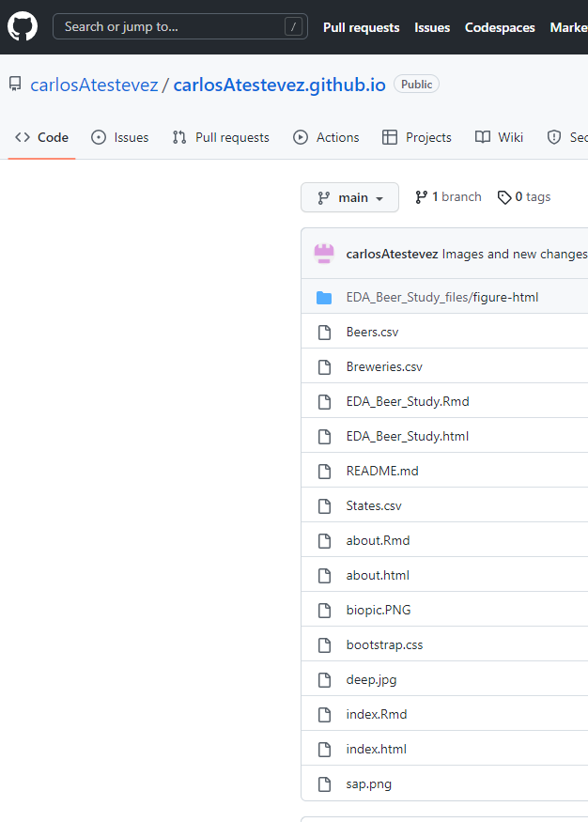
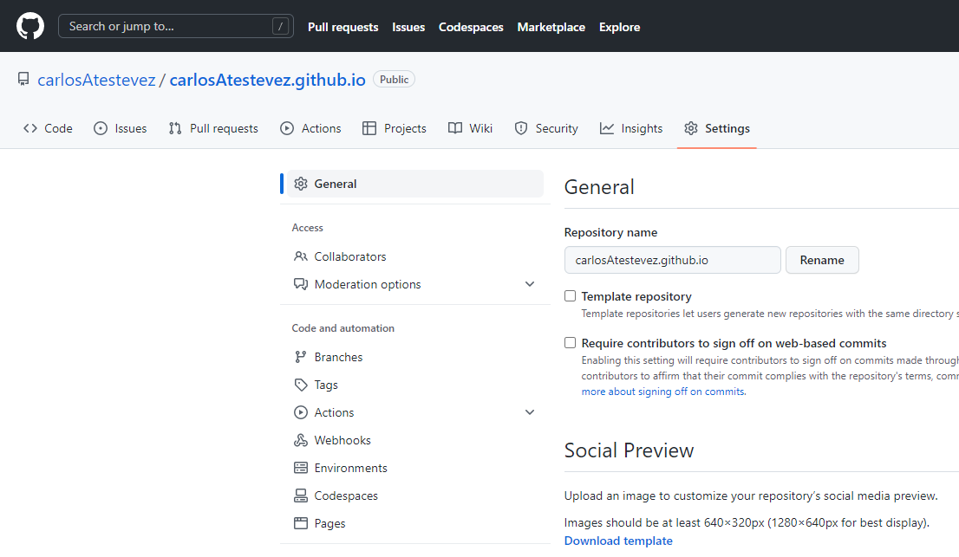
Activity two
URL repository:
https://github.com/carlosAtestevez/carlosAtestevez.github.io.git
URL Website:
https://carlosatestevez.github.io/

Slide 11
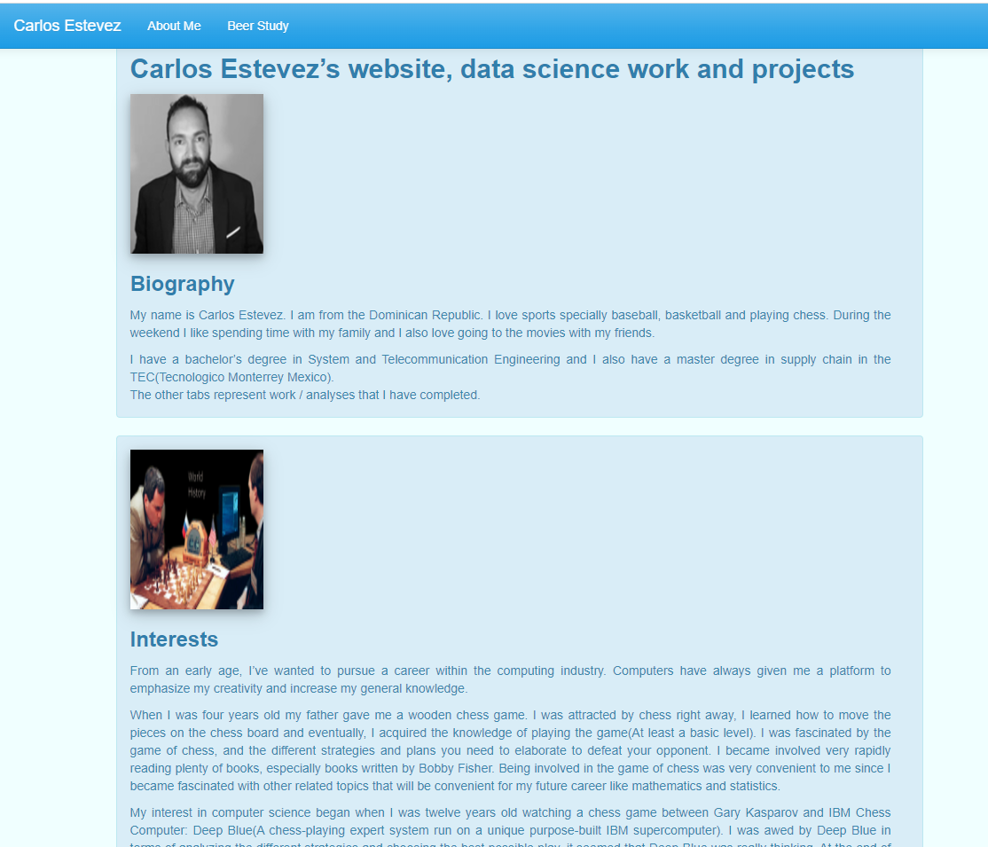
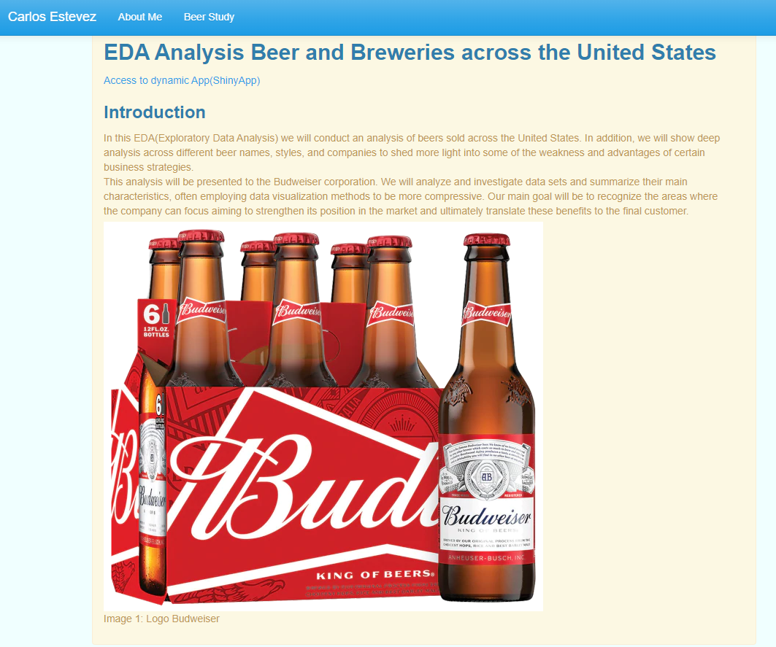
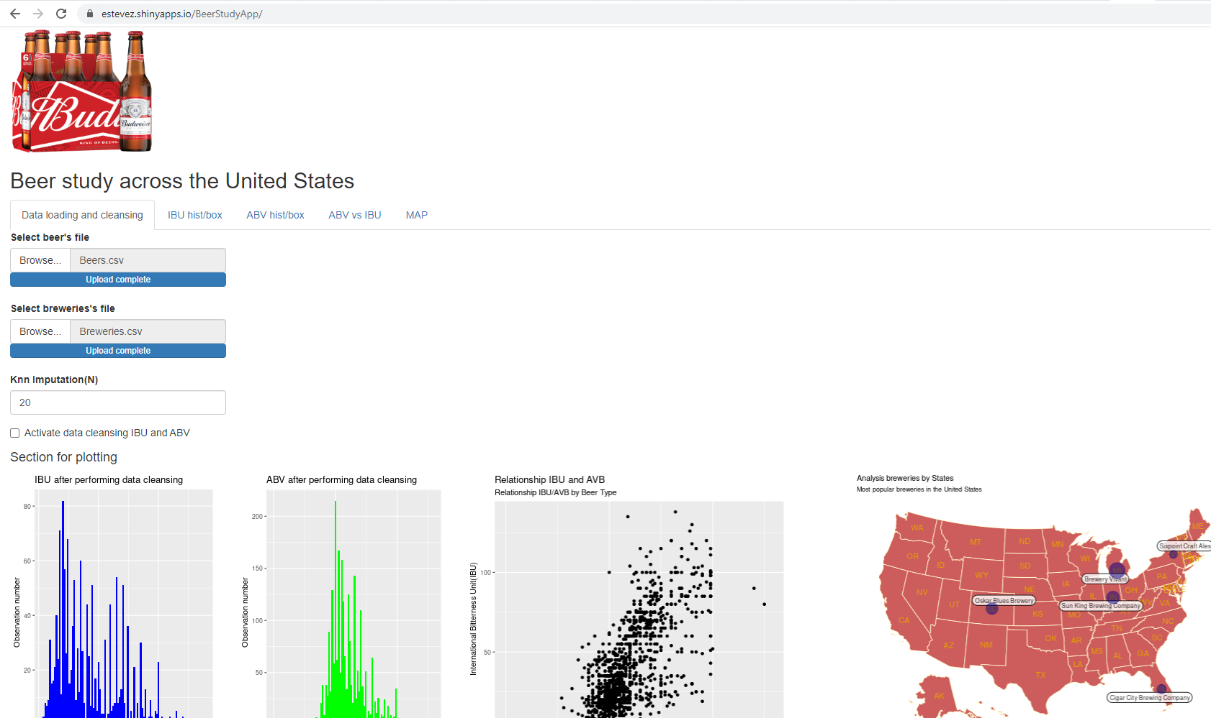
Activity three and four
Website
Comments
Website
URL:https://carlosatestevez.github.io/
Access to the ShinyApp
URL:https://estevez.shinyapps.io/BeerStudyApp/
Biography and Interests
Beer type Analysis

Slide 12
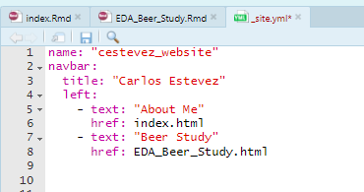
Activity three and four
YAML File

Slide 13
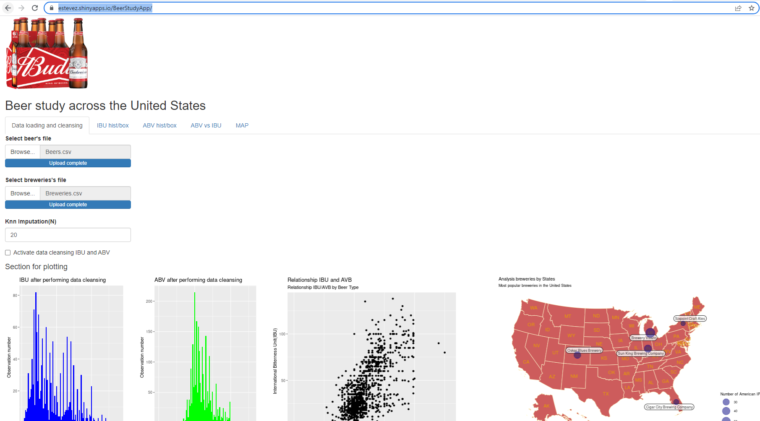
Activity five
Comments
Option for uploading datasets
Option for setting up the IBU histogram and box plot
Option for setting up the ABC histogram and box plot
Option for setting up a scatterplot between IBU and ABV
Additional report that shows the most important breweries across the United States
Additional option for replacing missing values using Knn imputation algorithm
URL Website:
https://carlosatestevez.github.io/
https://estevez.shinyapps.io/BeerStudyApp/

Slide 14
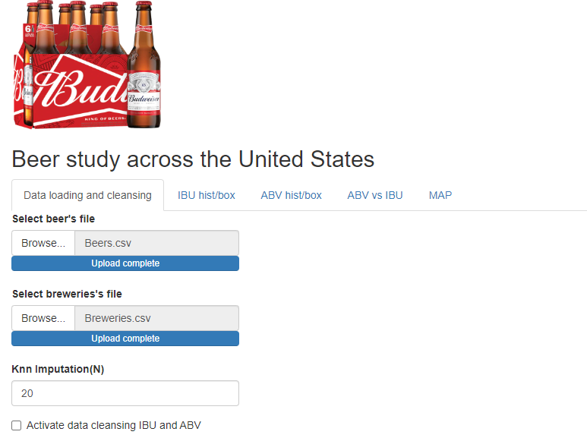
Activity five
URL Website:
https://carlosatestevez.github.io/
https://estevez.shinyapps.io/BeerStudyApp/
Option for uploading CSV files and Performing missing value imputation
*We must upload both files
We should activate the missing value imputation process in order to have a more meaningful analysis
The application will use the KNN algorithm to dealing with missing values for the variable IBU. The K default value is 20, however we have the option of picking another value
Comments

Slide 15
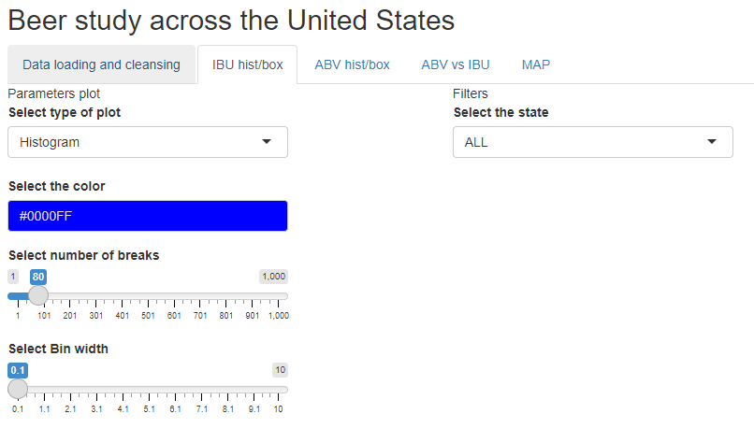
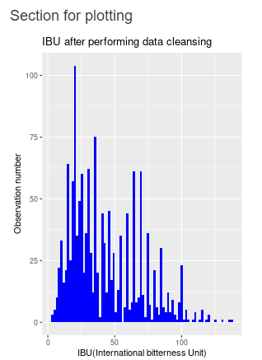
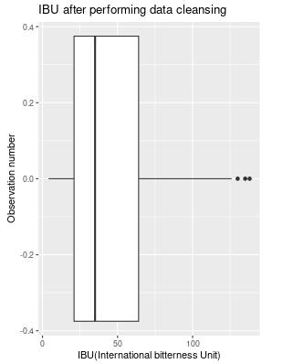
Activity five
URL Website:
https://carlosatestevez.github.io/
https://estevez.shinyapps.io/BeerStudyApp/
IBU Histogram and Boxplot
We can change the type of plot: Histogram or Boxplot
We can change the color of the histogram’s bins
We can change the number of bins we want to visualize
We can decide to filter by States
*ALL means that we will visualize the information for the entire country

Slide 16
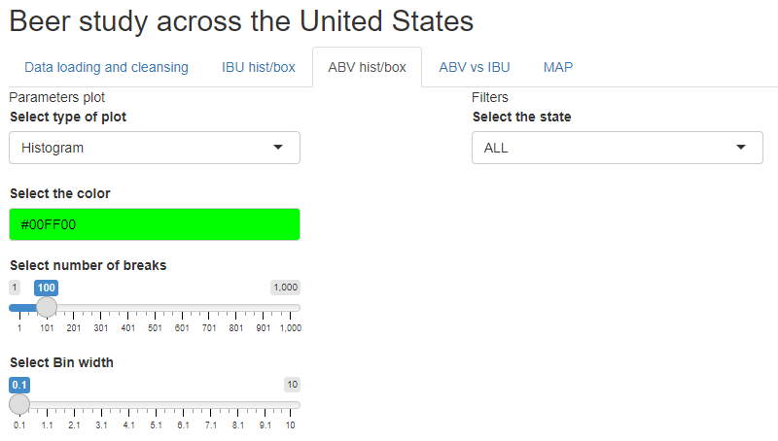
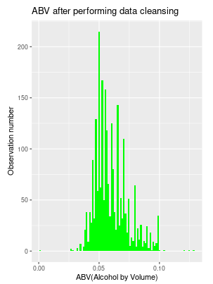
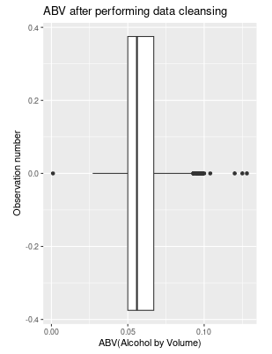
Activity five
URL Website:
https://carlosatestevez.github.io/
https://estevez.shinyapps.io/BeerStudyApp/
ABV Histogram and Boxplot
We can change the type of plot: Histogram or Boxplot
We can change the color of the histogram’s bins
We can change the number of bins we want to visualize
We can decide to filter by States
*ALL means that we will visualize the information for the entire country

Slide 17
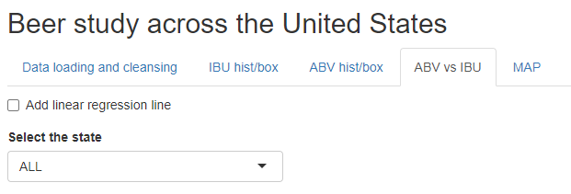
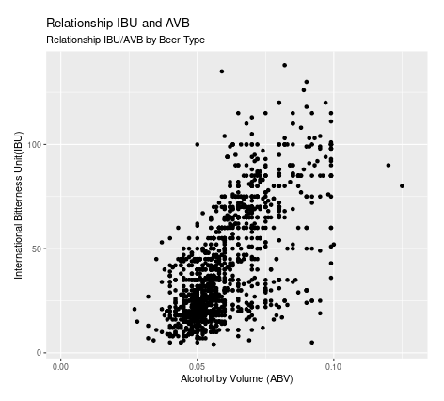
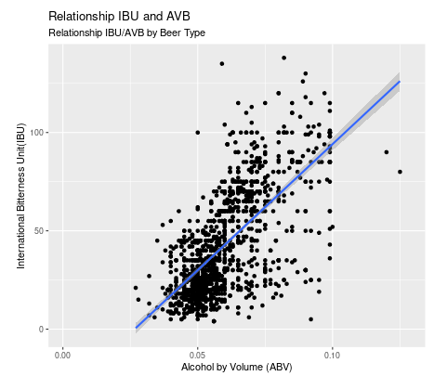
Activity five
URL Website:
https://carlosatestevez.github.io/
https://estevez.shinyapps.io/BeerStudyApp/
Scatterplot IBU vs ABV
In this section we can see the relationship between ABV and IBU
We have the option to add a regression line to the plot
We also are able to filter by States
*ALL means the entire country

Slide 18
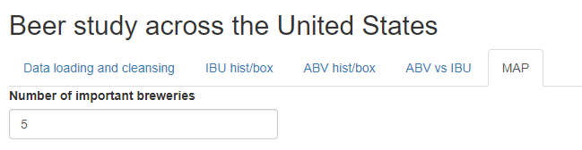
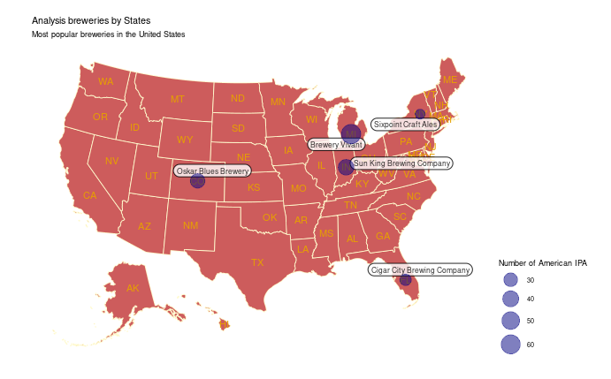
Activity five
URL Website:
https://carlosatestevez.github.io/
https://estevez.shinyapps.io/BeerStudyApp/
MAP
Most popular breweries
In this MAP we can visualize the most popular breweries across the United States
By default the MAP shows the five most popular breweries however, we can change the default value

Slide 19
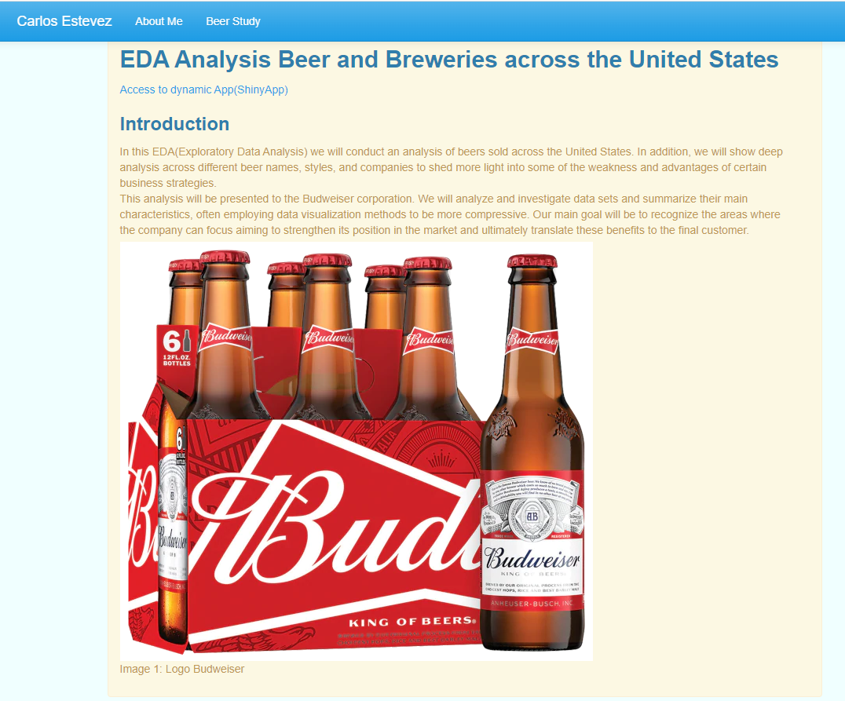
Activity five
URL Website:
https://carlosatestevez.github.io/
https://estevez.shinyapps.io/BeerStudyApp/
Website
Link to ShinyApp

Slide 20
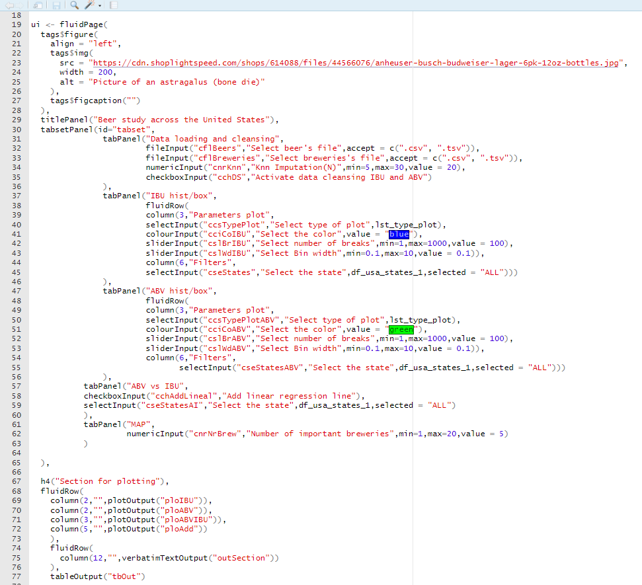
Activity five
URL Website:
https://carlosatestevez.github.io/
https://estevez.shinyapps.io/BeerStudyApp/
UI Interface
Parameters and Inputs
App image logo
Data loading/cleansing panel
IBU Hist/Box panel
ABV Hist/Box panel
IBU vs ABV panel
MAP panel
Output section
Plot for IBU
Plot for ABV
Plot for IBU vs ABV
Plot for MAP

Slide 21
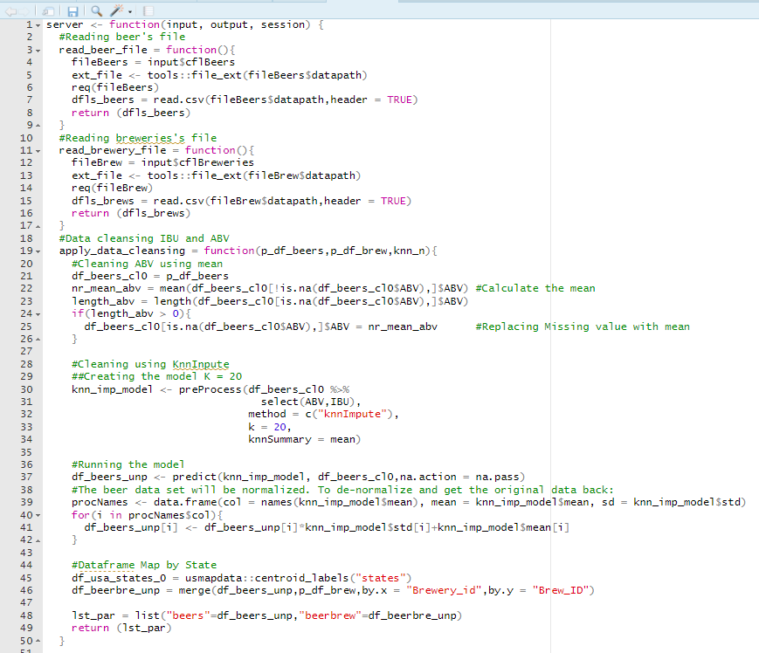
Activity five
URL Website:
https://carlosatestevez.github.io/
https://estevez.shinyapps.io/BeerStudyApp/
Server side
Functions
Reading beers csv file
Reading breweries csv file
Performing data cleansing

Slide 22
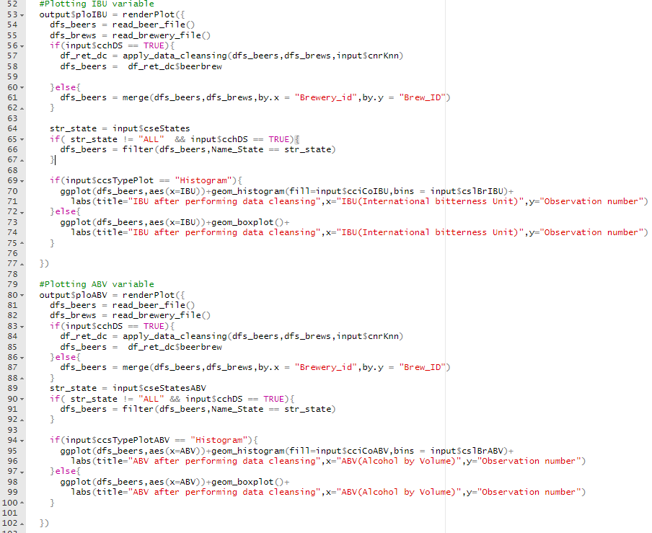
Activity five
URL Website:
https://carlosatestevez.github.io/
https://estevez.shinyapps.io/BeerStudyApp/
Server side
Plotting IBU using render plot
Call function to read beer csv
Call function to read breweries csv
We check if the user has set the DC flag and call the function for performing data cleansing
We validate if the user has selected a specific state to filter the values according to the selection
We check the type of plot selected by the user and plot the data. We also set the different parameters for ggplot like fill and bins
We pretty much do the same thing for ABV

Slide 23
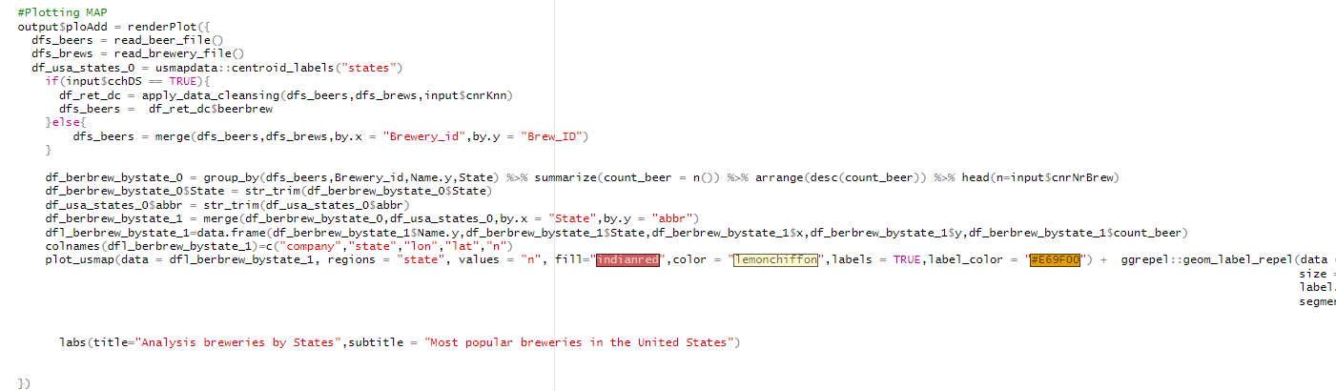
Activity five
URL Website:
https://carlosatestevez.github.io/
https://estevez.shinyapps.io/BeerStudyApp/
Server side
Plotting IBU using render plot
Call function to read beer csv
Call function to read breweries csv
We check if the user has set the DC flag and call the function for performing data cleansing
We plot the map and pass the number of breweries we want to visualize

Slide 24
Takeaways
Great lesson, I learned how to add dynamism to my data analysis
Questions
None

